Slide 1
Requirements Analysis and Specification

Slide 2
Organization of this Lecture
Introduction
Requirements analysis
Requirements specification
SRS document
Decision table
Decision tree
Summary

Slide 3
Requirements Analysis and Specification
Many projects fail:
because they start implementing the system:
without determining whether they are building what the customer really wants.
It is important to learn:
requirements analysis and specification techniques thoroughly.

Slide 4


Requirements ?
Being asked what you want out of a system is like being asked what you want out of life !
Where do you start !
What are the parameters !

Slide 5
Requirements Analysis and Specification
Goals of requirements analysis and specification phase:
fully understand the user requirements
remove inconsistencies, anomalies, etc. from requirements
document requirements properly in an SRS document
Consists of two distinct activities:
Requirements Gathering and Analysis
Specification

Slide 6
Requirements Analysis and Specification
The person who undertakes requirements analysis and specification:
known as systems analyst:
collects data pertaining to the product
analyzes collected data:
to understand what exactly needs to be done.
writes the Software Requirements Specification (SRS) document.
Final output of this phase:
Software Requirements Specification (SRS) Document.
The SRS document is reviewed by the customer.
reviewed SRS document forms the basis of all future development activities.

Slide 7
Requirements Analysis
Requirements analysis consists of two main activities:
Requirements gathering
Analysis of the gathered requirements
Analyst gathers requirements through:
observation of existing systems,
studying existing procedures,
discussion with the customer and end-users,
analysis of what needs to be done, etc.

Slide 8
Requirements Gathering
If the project is to automate some existing procedures
e.g., automating existing manual accounting activities,
the task of the system analyst is a little easier
analyst can immediately obtain:
input and output formats
accurate details of the operational procedures
In the absence of a working system,
lot of imagination and creativity are required.
Interacting with the customer to gather relevant data:
requires a lot of experience.

Slide 9


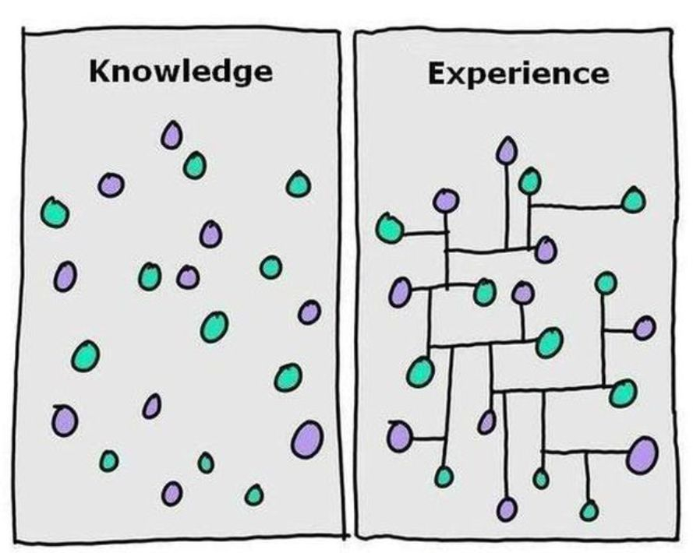
Requirements Gathering (CONT.)
Some desirable attributes of a good system analyst:
Good interaction skills,
imagination and creativity,
experience.

Slide 10
Requirement Gathering techniques
Interviews : Most common method
Questionnaires : collect information from a target population which is very large and in remote locations
Observations: Take notes while user is doing a process.
Facilitated Workshops: bring a larger group on a common platform to discuss and reach agreements. They help to define cross-functional requirements for a product
JAD :JAD (Joint Application Development) is a methodology that involves the client or end user in the design and development of an application, through a succession of collaborative workshops called JAD sessions.
Brainstorming : It involves self-generated contribution of ideas by the group members around a specific issue, problem or requirement.
Prototyping
Existing system/Documentation analysis

Slide 11
Analysis of the Gathered Requirements
After gathering all the requirements:
analyze it:
Clearly understand the user requirements,
Detect inconsistencies, ambiguities, and incompleteness.
Incompleteness and inconsistencies:
resolved through further discussions with the end-users and the customers.

Slide 12
Inconsistent requirement
Some part of the requirement:
contradicts with some other part.
Example:
One customer says turn off heater and open water shower when temperature > 100 C
Another customer says turn off heater and turn ON cooler when temperature > 100 C

Slide 13
Incomplete requirement
Some requirements have been omitted:
due to oversight.
Example:
The analyst has not recorded: when temperature falls below 90 C
heater should be turned ON
water shower turned OFF.

Slide 14
Analysis of the Gathered Requirements (CONT.)
Requirements analysis involves:
obtaining a clear, in-depth understanding of the product to be developed,
remove all ambiguities and inconsistencies from the initial customer perception of the problem.
It is quite difficult to obtain:
a clear, in-depth understanding of the problem:
especially if there is no working model of the problem.
Experienced analysts take considerable time:
to understand the exact requirements the customer has in his mind.
Experienced systems analysts know - often as a result of painful experiences ---
without a clear understanding of the problem, it is impossible to develop a satisfactory system.

Slide 15
Analysis of the Gathered Requirements(CONT.)
Several things about the project should be clearly understood by the analyst:
What is the problem?
Why is it important to solve the problem?
What are the possible solutions to the problem?
What complexities might arise while solving the problem?
Some anomalies and inconsistencies can be very subtle:
escape even most experienced eyes.
If a formal model of the system is constructed,
many of the subtle anomalies and inconsistencies get detected.

Slide 16
Software Requirements Specification
Main aim of requirements specification:
systematically organize the requirements arrived during requirements analysis
document requirements properly.
The SRS document is useful in various contexts:
statement of user needs
contract document
reference document
definition for implementation

Slide 17
Software Requirements Specification: A Contract Document
Requirements document is a reference document.
SRS document is a contract between the development team and the customer.
Once the SRS document is approved by the customer,
any subsequent controversies are settled by referring the SRS document.
Once customer agrees to the SRS document:
development team starts to develop the product according to the requirements recorded in the SRS document.
The final product will be acceptable to the customer:
as long as it satisfies all the requirements recorded in the SRS document.

Slide 18
SRS Document (CONT.)
The SRS document is known as black-box specification:
the system is considered as a black box whose internal details are not known.
only its visible external (i.e. input/output) behavior is documented.
SRS document concentrates on:
what needs to be done
carefully avoids the solution (“how to do”) aspects.
The SRS document serves as a contract
between development team and the customer.
Should be carefully written
I/p
O/p
S

Slide 19
Properties of a good SRS document
It should be concise
and at the same time should not be ambiguous.
It should specify what the system must do
and not say how to do it.
Easy to change.,
i.e. it should be well-structured.
It should be consistent.
It should be complete.
It should be traceable
you should be able to trace which part of the specification corresponds to which part of the design and code, etc and vice versa.
It should be verifiable
e.g. “system should be user friendly” is not verifiable

Slide 20
SRS Document (CONT.)
SRS document, normally contains three important parts:
functional requirements,
nonfunctional requirements,
constraints on the system.

Slide 21
SRS Document (CONT.)
It is desirable to consider every system:
performing a set of functions {fi}.
Each function fi considered as:
transforming a set of input data to corresponding output data.
Inp
O/p

Slide 22
Example: Functional Requirement
F1: Search Book
Input:
an author’s name:
Output:
details of the author’s books and the locations of these books in the library.
Inp
O/p

Slide 23
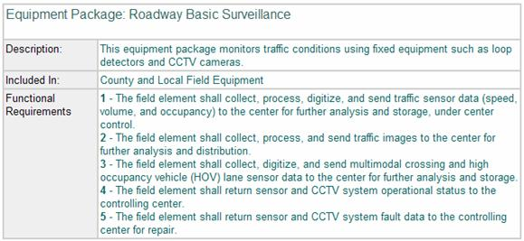

Slide 24
Functional Requirements
Functional requirements describe:
A set of high-level requirements
Each high-level requirement:
takes in some data from the user
outputs some data to the user
Each high-level requirement:
might consist of a set of identifiable functions
For each high-level requirement:
every function is described in terms of
input data set
output data set
processing required to obtain the output data set from the input data set

Slide 25
Nonfunctional Requirements
Characteristics of the system which can not be expressed as functions:
maintainability,
portability,
usability, etc.

Slide 26
Nonfunctional Requirements
Nonfunctional requirements include:
reliability issues,
performance issues,
human-computer interface issues,
Interface with other external systems,
security, maintainability, etc.

Slide 27
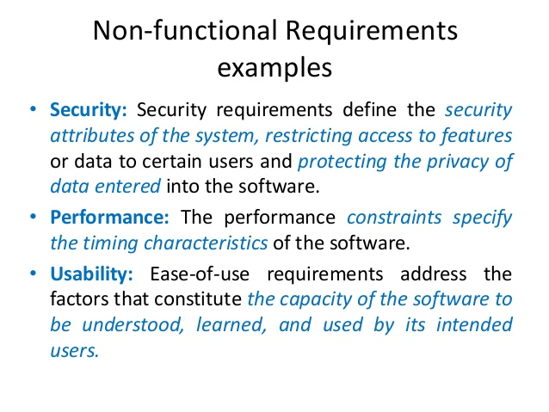

Slide 28
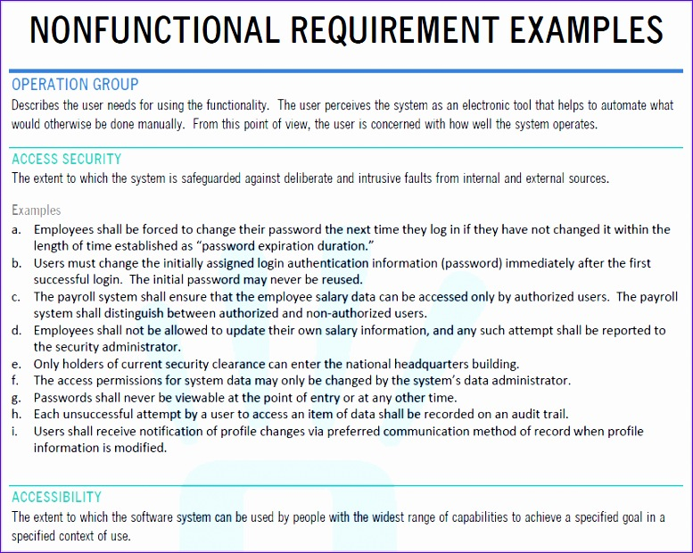

Slide 29
Non functional requirements
Execution qualities - such as safety, security and usability, which are observable during operation (at run time).
Evolution qualities, such as testability, maintainability, extensibility and scalability, which are embodied in the static structure of the system.

Slide 30
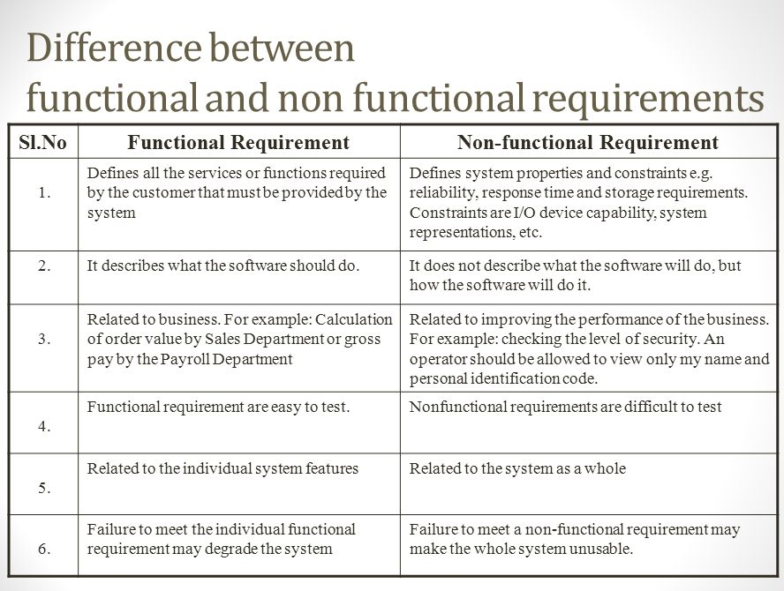

Slide 31
Constraints
Constraints describe things that the system should or should not do.
For example,
standards compliance
how fast the system can produce results
so that it does not overload another system to which it supplies data, etc.

Slide 32
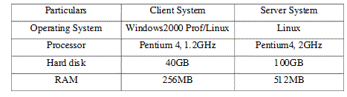
Examples of constraints
Hardware to be used,
Operating system
or DBMS to be used
Capabilities of I/O devices
Standards compliance
Data representations
by the interfaced system

Slide 33
Organization of the SRS Document
Introduction.
Functional Requirements
Nonfunctional Requirements
External interface requirements
Performance requirements
Constraints

Slide 34
Example Functional Requirements
List all functional requirements
with proper numbering.
Req. 1:
Once the user selects the “search” option,
he is asked to enter the key words.
The system should output details of all books
whose title or author name matches any of the key words entered.
Details include: Title, Author Name, Publisher name, Year of Publication, ISBN Number, Catalog Number, Location in the Library.

Slide 35
Example Functional Requirements
Req. 2:
When the “renew” option is selected,
the user is asked to enter his membership number and password.
After password validation,
the list of the books borrowed by him are displayed.
The user can renew any of the books:
by clicking in the corresponding renew box.

Slide 36
Req. 1:
R.1.1:
Input: “search” option,
Output: user prompted to enter the key words.
R1.2:
Input: key words
Output: Details of all books whose title or author name matches any of the key words.
Details include: Title, Author Name, Publisher name, Year of Publication, ISBN Number, Catalog Number, Location in the Library.
Processing: Search the book list for the keywords

Slide 37
Req. 2:
R2.1:
Input: “renew” option selected,
Output: user prompted to enter his membership number and password.
R2.2:
Input: membership number and password
Output:
list of the books borrowed by user are displayed. User prompted to enter books to be renewed or
user informed about bad password
Processing: Password validation, search books issued to the user from borrower list and display.

Slide 38
Req. 2:
R2.3:
Input: user choice for renewal of the books issued to him through mouse clicks in the corresponding renew box.
Output: Confirmation of the books renewed
Processing: Renew the books selected by the in the borrower list.

Slide 39
Examples of Bad SRS Documents
Unstructured Specifications:
Narrative essay --- one of the worst types of specification document:
Difficult to change,
difficult to be precise,
difficult to be unambiguous,
scope for contradictions, etc.
Noise:
Presence of text containing information irrelevant to the problem.
Silence:
aspects important to proper solution of the problem are omitted.

Slide 40
Examples of Bad SRS Documents
Overspecification:
Addressing “how to” aspects
For example, “Library member names should be stored in a sorted descending order”
Overspecification restricts the solution space for the designer.
Contradictions:
Contradictions might arise
if the same thing described at several places in different ways.
Ambiguity:
Literary expressions
Unquantifiable aspects, e.g. “good user interface”
Forward References:
References to aspects of problem
defined only later on in the text.
Wishful Thinking:
Descriptions of aspects
for which realistic solutions will be hard to find.

Slide 41
Representation of complex processing logic:
Decision trees
Decision tables

Slide 42
What is a Decision tree
A decision tree is a graph that uses a branching method to illustrate every possible outcome of a decision

Slide 43
Decision Trees
Decision trees:
edges of a decision tree represent conditions
leaf nodes represent actions to be performed.
A decision tree gives a graphic view of:
logic involved in decision making
corresponding actions taken.
Example: LMS
A Library Membership automation Software (LMS) should support the following three options:
new member,
renewal,
cancel membership.

Slide 44
Example: LMS
When the new member option is selected,
the software asks details about the member:
name,
address,
phone number, etc.
If proper information is entered,
a membership record for the member is created
a bill is printed for the annual membership charge plus the security deposit payable.

Slide 45
Example(cont.)
If the renewal option is chosen,
LMS asks the member's name and his membership number
checks whether he is a valid member.
If the name represents a valid member,
the membership expiry date is updated and the annual membership bill is printed,
otherwise an error message is displayed.

Slide 46
Example(cont.)
If the cancel membership option is selected and the name of a valid member is entered,
the membership is cancelled,
a cheque for the balance amount due to the member is printed
the membership record is deleted.

Slide 47
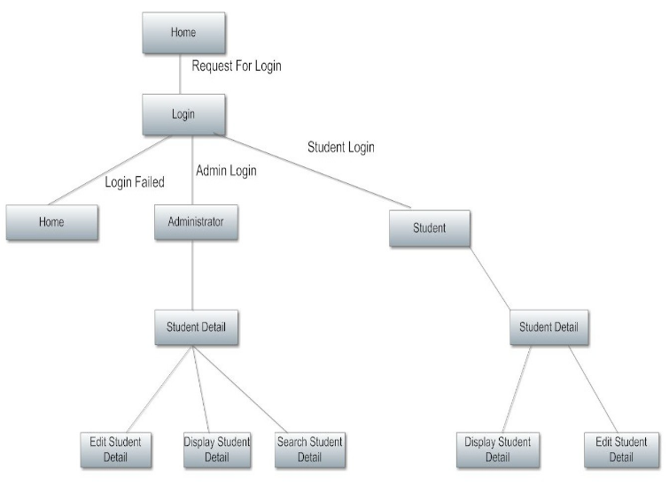
Student Information Management System

Slide 48
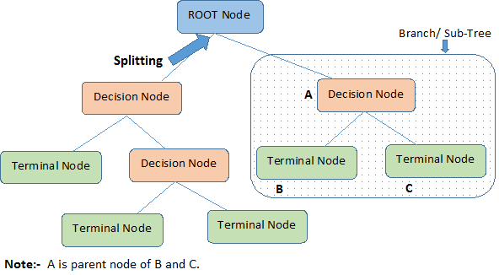
Decision Tree as we understand

Slide 49
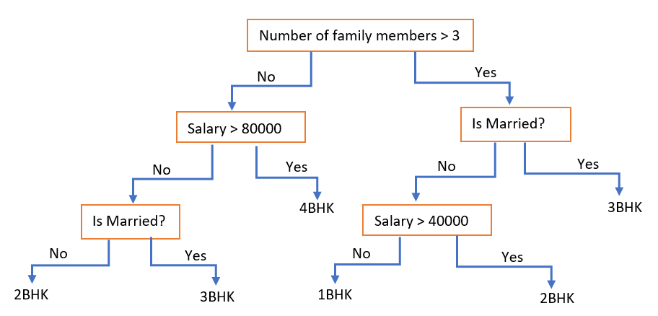

Slide 50
Decision table
Decision tables are a concise visual representation for specifying which actions to perform depending on given conditions.
They are algorithms whose output is a set of actions.
The information expressed in decision tables could also be represented as decision trees or in a programming language as a series of if-then-else and switch-case statements.

Slide 51
Decision Table
Decision tables specify:
which variables are to be tested
what actions are to be taken if the conditions are true,
the order in which decision making is performed.

Slide 52
Decision Table
A decision table shows in a tabular form:
processing logic and corresponding actions
Upper rows of the table specify:
the variables or conditions to be evaluated
Lower rows specify:
the actions to be taken when the corresponding conditions are satisfied.
In technical terminology,
a column of the table is called a rule:
A rule implies:
if a condition is true, then execute the corresponding action.

Slide 53
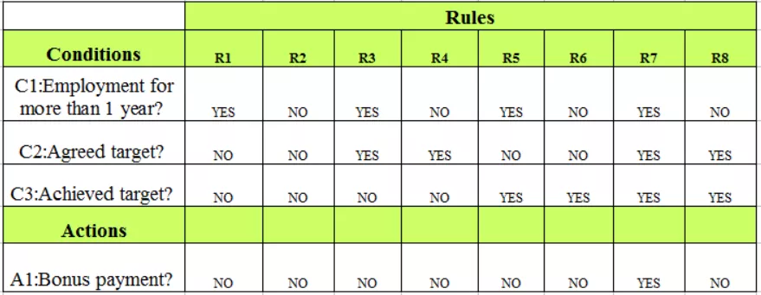
Algorithm for Bonus Payment
Upper rows - conditions
Lower rows - Actions
Column - Rule

Slide 54
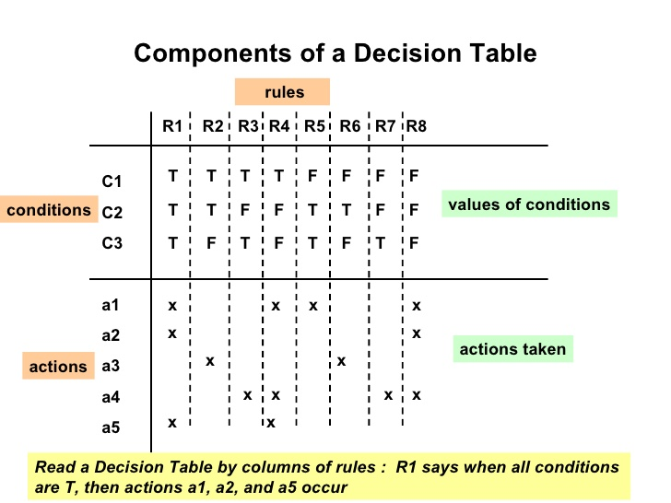

Slide 55
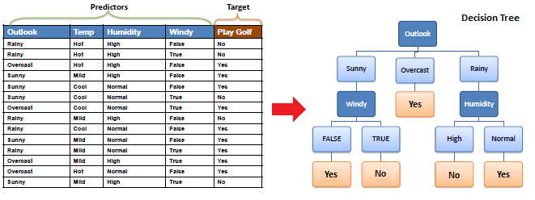
Table to Tree ?

Slide 56
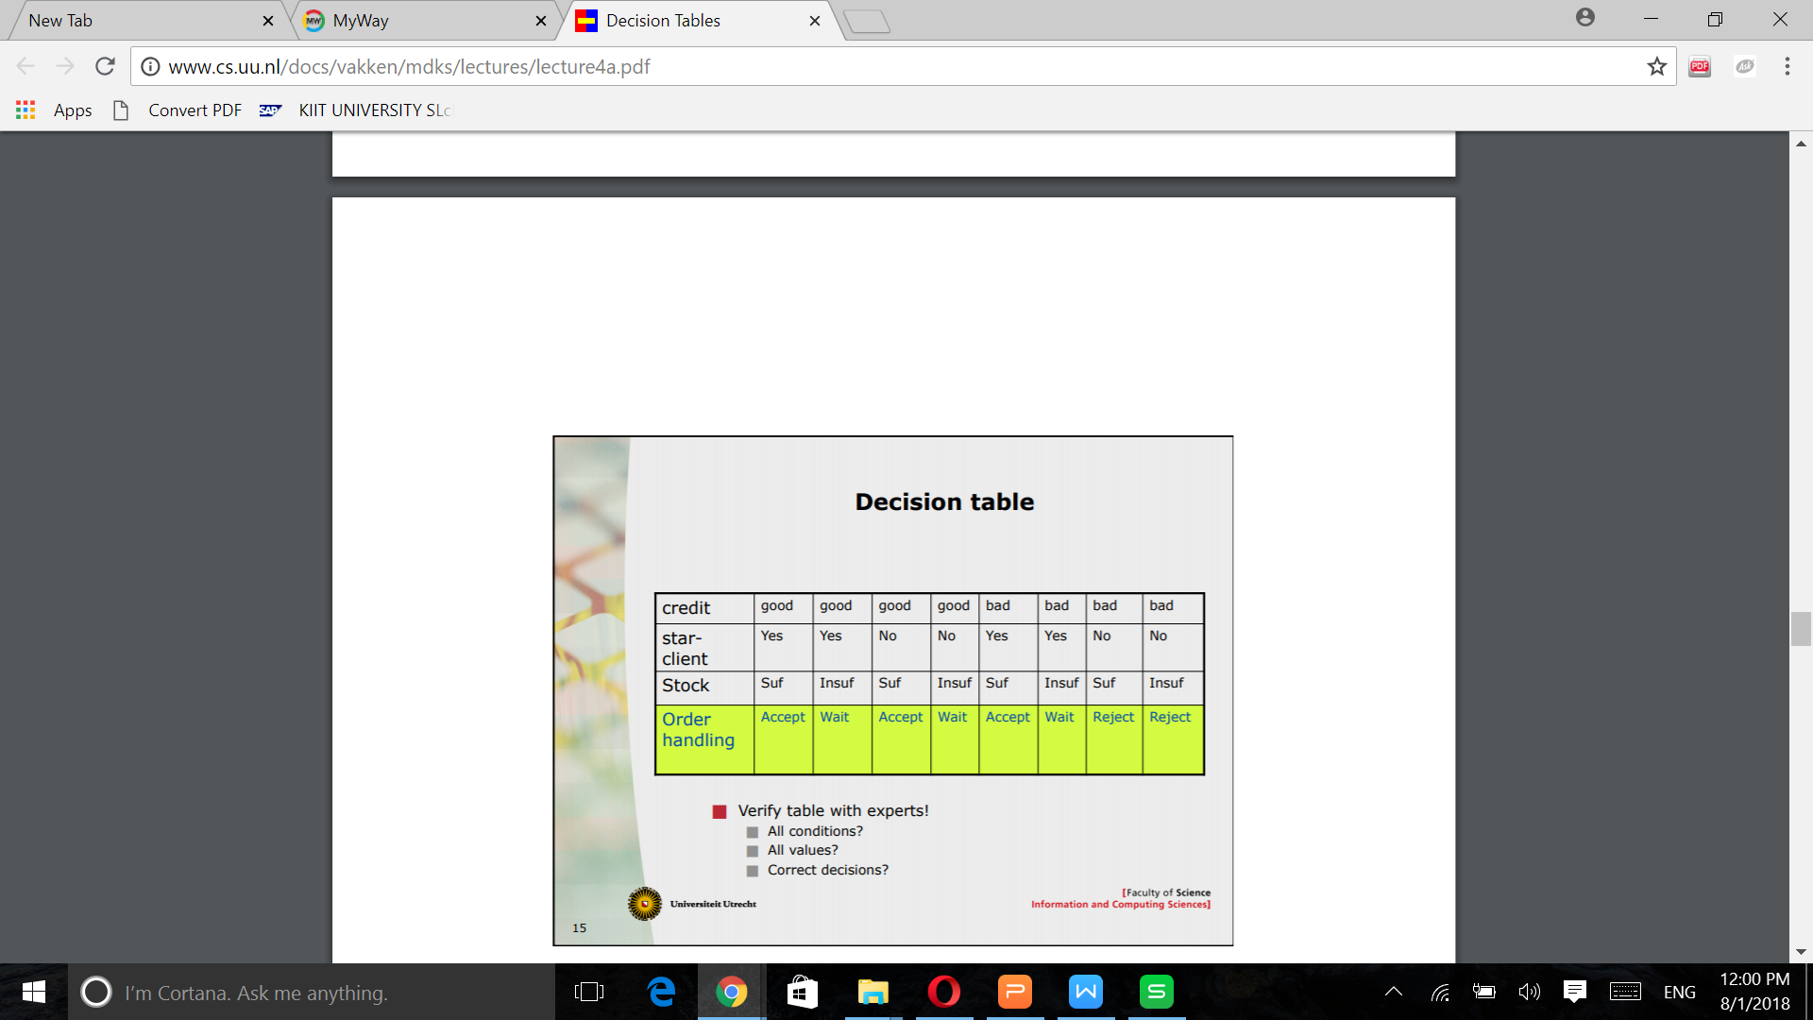
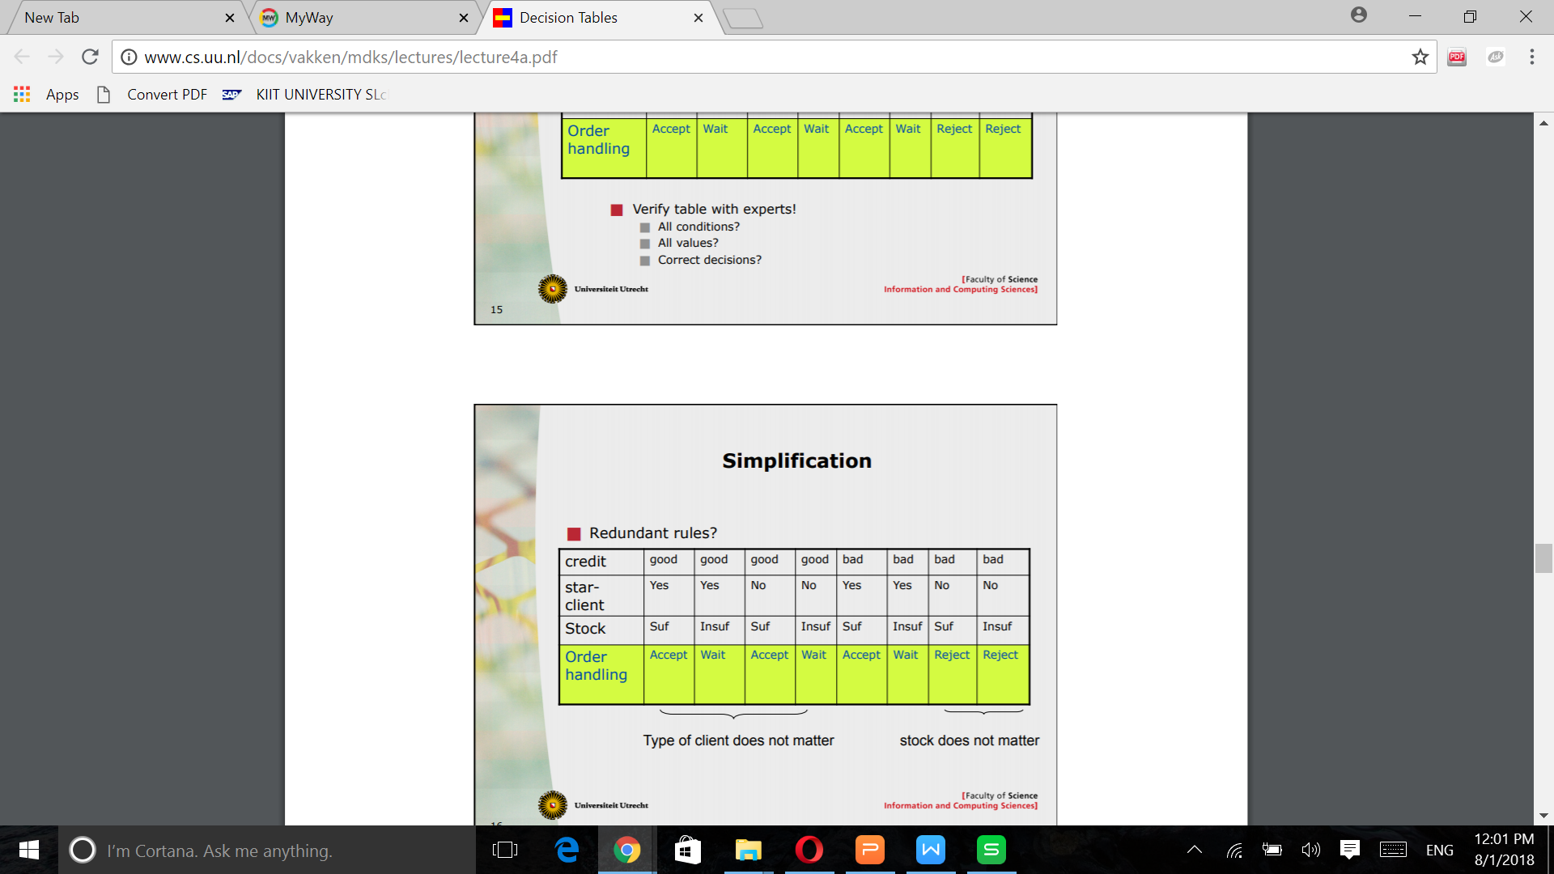

Slide 57
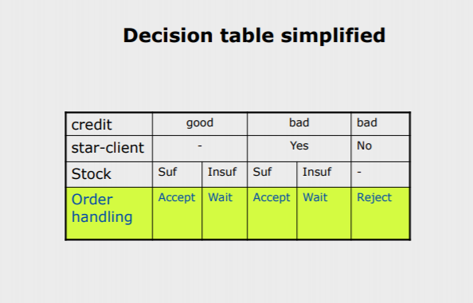

Slide 58
Example:
Conditions Valid selection NO YES YES YES New member -- YES NO NO Renewal -- NO YES NO Cancellation -- NO NO YES
Actions Display error message -- -- -- Ask member's name etc. Build customer record -- -- -- Generate bill -- -- Ask membership details -- Update expiry date -- -- -- Print cheque -- -- -- Delete record -- -- --

Slide 59
Comparison
Both decision tables and decision trees
can represent complex program logic.
Decision trees are easier to read and understand
when the number of conditions are small.
Decision tables help to look at every possible combination of conditions.

Slide 60
Formal Specification
A formal specification technique is a mathematical method to:
accurately specify a system
verify that implementation satisfies specification
prove properties of the specification

Slide 61
Formal Specification
A formal software specification is a statement expressed in a language whose vocabulary, syntax, and semantics are formally defined.
The need for a formal semantic definition means that the specification languages cannot be based on natural language;
It must be based on mathematics.

Slide 62
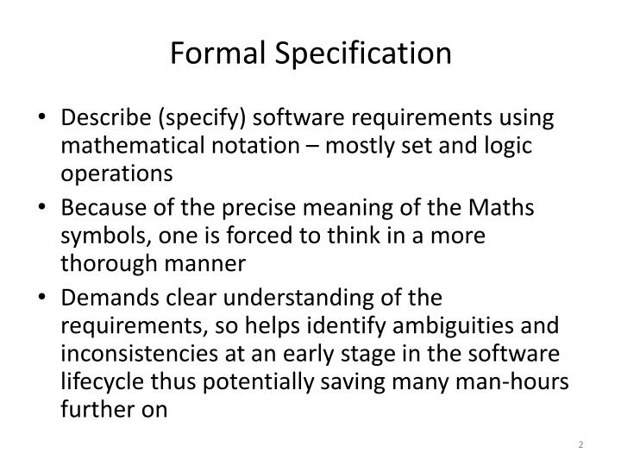

Slide 63
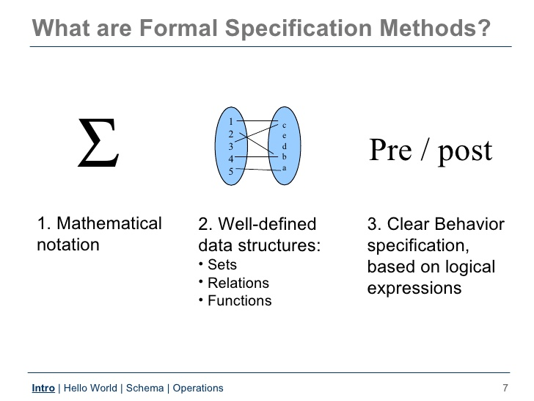

Slide 64
Acceptance of formal methods
Formal methods have not become mainstream software development techniques as was once predicted
Other software engineering techniques have been successful at increasing system quality. Hence the need for formal methods has been reduced
Market changes have made time-to-market rather than software with a low error count the key factor. Formal methods do not reduce time to market
The scope of formal methods is limited. They are not well-suited to specifying and analysing user interfaces and user interaction
Formal methods are hard to scale up to large systems

Slide 65
Use of formal methods
Their principal benefits are in reducing the number of errors in systems so their main area of applicability is critical systems:
Air traffic control information systems,
Railway signalling systems
Spacecraft systems
Medical control systems
In this area, the use of formal methods is most likely to be cost-effective
Formal methods have limited practical applicability

Slide 66
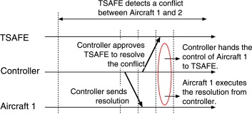

Slide 67
Formal Specification
Advantages:
Well-defined semantics, no scope for ambiguity
Automated tools can check properties of specifications
Executable specification
Disadvantages of formal specification techniques:
Difficult to learn and use
Not able to handle complex systems

Slide 68
Formal Specification
Mathematical techniques used include:
Logic-based
set theoretic
algebraic specification
finite state machines, etc.

Slide 69
Semiformal Specification
Structured specification languages
SADT (Structured Analysis and Design Technique)
PSL/PSA (Problem Statement Language/Problem Statement Analyzer)
PSL is a semi-formal specification language
PSA can analyze the specifications expressed in PSL

Slide 70
Executable Specification Language
If specification is expressed in formal language:
it becomes possible to execute the specification to provide a system prototype.
However, executable specifications are usually slow and inefficient.

Slide 71
Executable Specification Language
Executable specifications only test functional requirements:
If non-functional requirements are important for some product,
the utility of an executable specification prototype is limited.

Slide 72
4GLs
4GLs (Fourth Generation Languages) are examples of
executable specification languages.
Eg. SQL, Mathematica
4GLs are successful
because there is a lot of commonality across data processing applications.

Slide 73
4GLs
4GLs rely on software reuse
where common abstractions have been identified and parameterized.
Rewriting 4GL programs in higher level languages:
result in upto 50% lower memory requirements
also the programs run upto 10 times faster.

Slide 74
Summary
Requirements analysis and specification
an important phase of software development:
any error in this phase would affect all subsequent phases of development.
Consists of two different activities:
Requirements gathering and analysis
Requirements specification

Slide 75
Summary
The aims of requirements analysis:
Gather all user requirements
Clearly understand exact user requirements
Remove inconsistencies and incompleteness.
The goal of specification:
systematically organize requirements
document the requirements in an SRS document.

Slide 76
Summary
Main components of SRS document:
functional requirements
nonfunctional requirements
constraints
Techniques to express complex logic:
Decision tree
Decision table

Slide 77
Summary
Formal requirements specifications have several advantages.
But the major shortcoming is that these are hard to use.

Slide 78
Activity 2 - write SRS

Slide 79
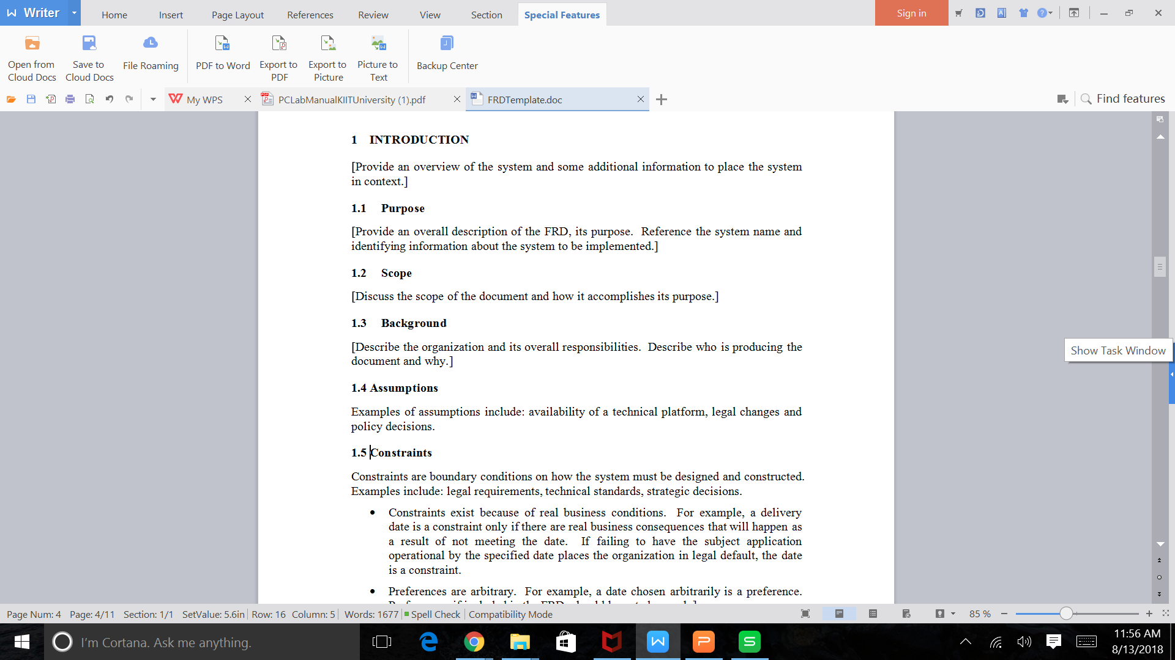
SRS template

Slide 80
Functional requirements
Functional Requirements should include:
Descriptions of data to be entered into the system
Descriptions of operations performed by each screen
Descriptions of work-flows performed by the system
Descriptions of system reports or other outputs
Who can enter the data into the system
How the system meets applicable regulatory requirements

Slide 81
Example

Slide 82
Non Functional requirements
Performance – for example Response Time, Throughput, Utilization, Static Volumetric.
Scalability.
Capacity.
Availability.
Reliability.
Recoverability.
Maintainability.
And also write constraints

